Slide 1
Commands to Collect System and Hardware Information in Linux , Communicating with Other Users , Linux File permission and File types In Linux

Slide 2

To know only the system name, you can use the uname command without any switch that will print system information or the uname -s command will print the kernel name of your system.
To view your network hostname, use the ‘-n’ switch with the uname command as shown.
To get information about kernel-version, use the ‘-v’ switch.
tecmint@tecmint ~ $ uname -n
tecmint.com
tecmint@tecmint ~ $ uname -v
#64-Ubuntu SMP Mon Sep 22 21:28:38 UTC 2014

Slide 3
To get the information about your kernel release, use the ‘-r’ switch.
To print your machine hardware name, use the ‘-m’ switch:
All this information can be printed at once by running the ‘uname -a’ command as shown below.
ecmint@tecmint ~ $ uname -r
3.13.0-37-generic
tecmint@tecmint ~ $ uname -m
x86_64
tecmint@tecmint ~ $ uname -a
Linux tecmint.com 3.13.0-37-generic #64-Ubuntu SMP Mon Sep 22 21:28:38
UTC 2014 x86_64 x86_64 x86_64 GNU/Linux

Slide 4
View Linux CPU Information
The lsusb command is used to report information about USB controllers and all the devices that are connected to them.
You can use the -v option to generate detailed information about each USB device.
tecmint@tecmint ~ $ lsusb
Bus 001 Device 002: ID 8087:8000 Intel Corp.
Bus 001 Device 001: ID 1d6b:0002 Linux Foundation 2.0 root hub.
Bus 003 Device 001: ID 1d6b:0003 Linux Foundation 3.0 root hub.
Bus 002 Device 005: ID 0bda:b728 Realtek Semiconductor Corp.
Bus 002 Device 004: ID 5986:0249 Acer, Inc
Bus 002 Device 003: ID 0bda:0129 Realtek Semiconductor Corp. RTS5129 Card Reader Controller
Bus 002 Device 002: ID 045e:00cb Microsoft Corp. Basic Optical Mouse v2.0
Bus 002 Device 001: ID 1d6b:0002 Linux Foundation 2.0 root hub
tecmint@tecmint ~ $ lsusb -v

Slide 5
Peripheral Component Interconnect (PCI)
Peripheral Component Interconnect (PCI) was a common connection interface slot in a computer’s motherboard introduced by Intel in 1992. Although it has been replaced by PCI Express (PCIe) slots, from the late 1990s to early 2000s PCI slots are quite common. It’s often used to attach hardwares like sound cards, video cards and modem with the motherboard.
By this logic, a PCI device means any device that can connect into the motherboard by utilizing the PCI slot.

Slide 6
Significance of PCI Devices
While it’s quite rare nowadays, some older computers operating today still use PCI slots. PCI slots can connect to many devices, such as:
Network cards
Sound cards
Graphics cards
Controller cards
Modem
Scanner

Slide 7
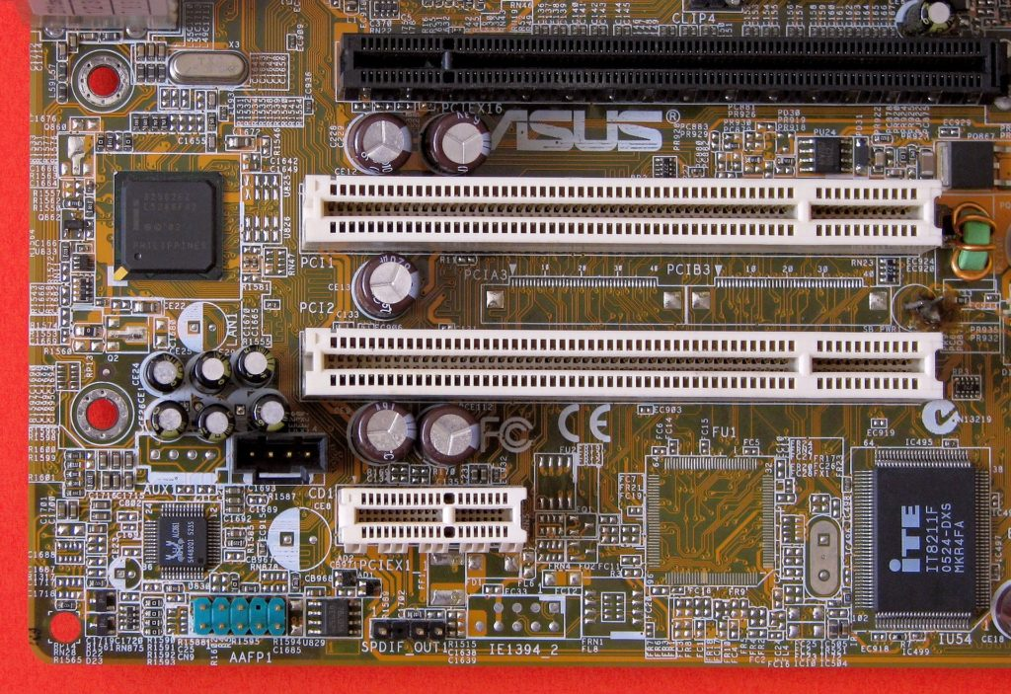

Slide 8
Print PCI Devices Information
PCI devices may include usb ports, graphics cards, network adapters, etc. The lspci tool is used to generate information concerning all PCI controllers on your system plus the devices that are connected to them.
To print information about PCI devices run the following command.
tecmint@tecmint ~ $ lspci
00:00.0 Host bridge: Intel Corporation Haswell-ULT DRAM Controller (rev 0b)
00:02.0 VGA compatible controller: Intel Corporation Haswell-ULT Integrated Graphics Controller (rev 0b)
00:03.0 Audio device: Intel Corporation Haswell-ULT HD Audio Controller(rev 0b)
00:14.0 USB controller: Intel Corporation Lynx Point-LP USB xHCI HC (rev 04)
00:16.0 Communication controller: Intel Corporation Lynx Point-LP HECI #0 (rev 04)
00:1b.0 Audio device: Intel Corporation Lynx Point-LP HD Audio Controller (rev 04)

Slide 9
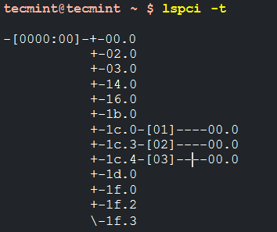
Use the -t option to produce output in a tree format.
Use the -v option to produce detailed information about each connected device.
tecmint@tecmint ~ $ lspci –v
VGA compatible controller: Intel Corporation Haswell-ULT
Integrated Graphics Controller (rev 0b)
(prog-if 00 [VGA controller]) Subsystem: Lenovo Device 380d
Flags: bus master, fast devsel, latency 0, IRQ 62
Memory at c3000000 (64-bit, non-prefetchable) [size=4M]
Memory at d0000000 (64-bit, prefetchable) [size=256M]
I/O ports at 6000 [size=64] Expansion ROM at [disabled]
Capabilities:
Kernel driver in use: i915.....

Slide 10
Print Information about SATA Devices
You can find some information about sata devices on your system as follows using the hdparm utility. In the example below, I used the block device /dev/sda1 which is the hard disk on my system.
tecmint@tecmint ~ $ sudo hdparm /dev/sda1
/dev/sda1:
multcount = 0 (off)
IO_support = 1 (32-bit)
readonly = 0 (off)
readahead = 256 (on)
geometry = 56065/255/63,
sectors = 2048000,
start = 2048

Slide 11
To print information about device geometry in terms of cylinders, heads, sectors, size, and the starting offset of the device, use the -g option.
tecmint@tecmint ~ $ sudo hdparm -g /dev/sda1
/dev/sda1: geometry = 56065/255/63,
sectors = 2048000, start = 2048

Slide 12
Check Linux File System Information
To gather information about file system partitions, you can use the fdisk command. Although the main functionality of the fdisk command is to modify file system partitions, it can also be used to view information about the different partitions on your file system.
You can print partition information as follows. Remember to run the command as a superuser or else you may not see any output.

Slide 13
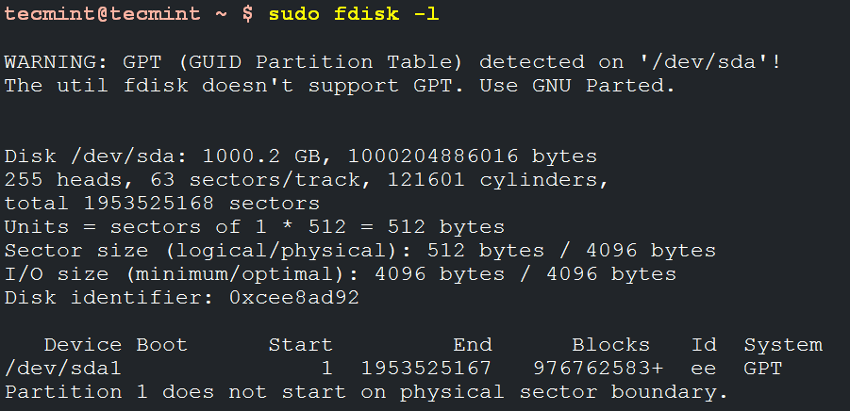

Slide 14
Communicating with Other Users

Slide 15
Conditions for sharing a message
User must login
User must enable message

Slide 16
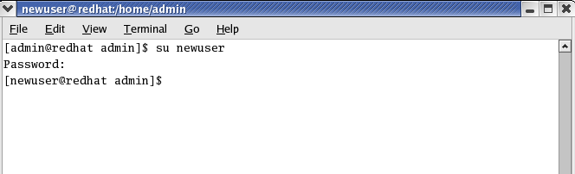
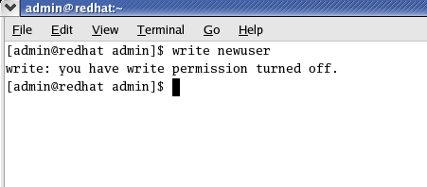

Slide 17
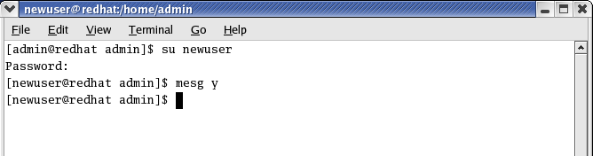
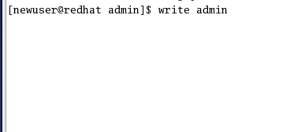
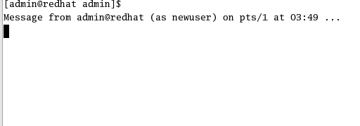

Slide 18
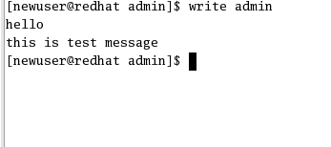
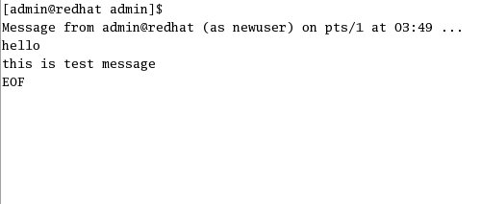

Slide 19
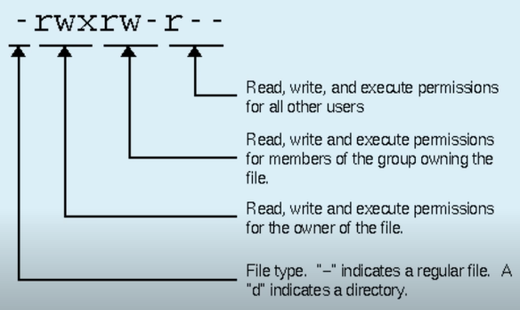
Linux File permission

Slide 20
File types In Linux

Slide 21
File types
Directory files(d)
Regular files(-)
Special files(This category is having 5 sub types in it.)

Slide 22
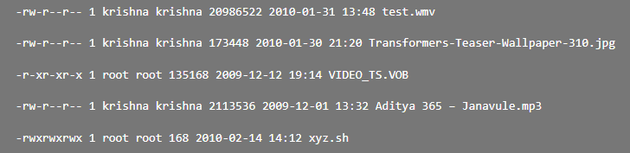
Regular File
1. Readable file or 2. A binary file or 3. Image files or 4. Compressed files etc.

Slide 23
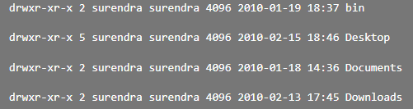
Directory File
These type of files contains regular files/folders/special files stored on a physical device. And this type of files will be in blue in color with link greater than or equal 2.

Slide 24
Special files
Block file(b)
Character device file(c)
Named pipe file or just a pipe file(p)
Symbolic link file(l)
Socket file(s)

Slide 25
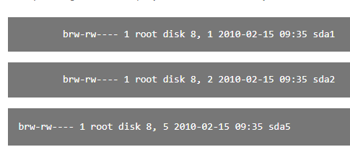
Block File Type In Linux
These files are hardware files most of them are present in /dev.

Slide 26
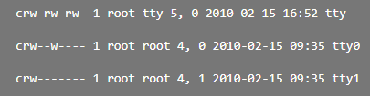
Character Device Files In Linux
Provides a serial stream of input or output. Your terminals are classic example for this type of files.

Slide 27
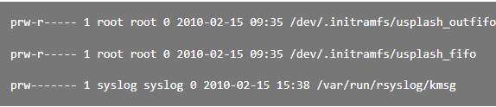
Pipe Files
The other name of pipe is a “named” pipe, which is sometimes called a FIFO. FIFO stands for “First In, First Out” and refers to the property that the order of bytes going in is the same coming out. The “name” of a named pipe is actually a file name within the file system.

Slide 28
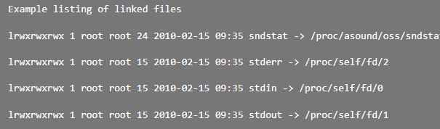
Symbolic Link Files In Linux
These are linked files to other files. They are either Directory/Regular File. The inode number for this file and its parent files are same. There are two types of link files available in Linux/Unix ie soft and hard link.

